Slide 1
Course: Professional Issues in IT
Course Instructor: Shaharbano
Email address: shahar.bano@nu.edu.pk
Lec # 11

Slide 2
Investment Appraisal
Less resources and more number of proposals lead company owners and investors to decide which proposal to drop which to pick.
Investment appraisal is a process that evaluates the costs and benefits of an investment to determine its suitability. It involves analyzing the profitability of an investment over the life of an asset, as well as its affordability and strategic fit

Slide 3
Investing in…..
There is no single way of assessing and comparing the different proposals;
factors that must be taken into consideration include, for example:
the extent to which the proposals are consistent with the company’s
long-term plans;
the risk attached to the proposals;
the availability of the necessary resources even if the money is available.

Slide 4
DCF(Discounted cash flow)
One important criterion, however, is the financial one: which of the proposals
will give the best return on the investment? The usual way of determining
this is to use the method known as discounted cash flow (DCF)

Slide 5
DCF
It is important to realize that DCF is a tool that is used for many different
purposes, for example:
by investors on the stock market to assess whether the share price of a company reflects accurately its financial prospects;
to assess whether it is better to purchase capital equipment or to lease it;
to decide which of several possible projects is the most financially appealing;
to decide whether a proposed capital project will be worthwhile.

Slide 6
THE TIME VALUE OF MONEY
Money available at present time is worth more than the same amount in the future due to its potential earning capacity.

Slide 7
Purchasing vs leasing
Suppose you want to get a car worth Rs.10,00,000/- and you have that amount.
The car finance department offers you to lease the car providing you pay a down payment of 20% that is Rs.2,00,000/- and a monthly payment of Rs.20,000 for 5 years(60 months).
Thus,
(20,000 * 60) + 2,00,000 = 14,00,000
While if you purchase it you have to pay Rs. 10,00,000/-
Would you purchase the car or lease it on these terms?

Slide 8
Interest rate
Suppose you put your Rs.10,00,000/- in the bank provided the bank gives you an interest of 10% per annum
Thus
(10/100) * 10,00,000 = 100,000 per annum

Slide 9
Discount factor
In general, if the interest rate is r (expressed as a fraction such as 0.08, not a percentage), then the present value of a sum of money X due in t years time is:
X ÷ (1 + r)^{t}
Or,
The quantity 1 ÷ (1 + r)^{t} is known as the discount factor.

Slide 10
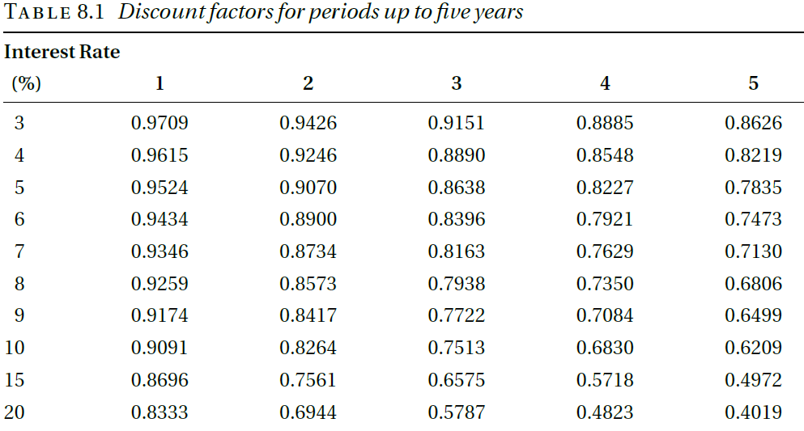
Notes:
8 per cent over a period of four years is 0.7350. This means that, if the discount
rate is 8 per cent, the present value of a sum of £1,000 payable in four
years time is £1000 ⋅ 0.7350 = £735.

Slide 11
Example
A new van will cost £10,000. There will be annual costs of £500 for insurance and £150 for road tax. The cost of maintenance is estimated to be £200 in each of the first two years, £300 in year 3, £400 in year 4 and £500 in year 5.
At the end of the fifth year, it is expected that the van will be sold for around £2,000. The interest rate that the company pays on its borrowings is 10 percent.

Slide 12
If the van is hired(rented)
Van hire costs £35 per day and it hires a van for about 100 days a year. All the costs are subject to inflation, which is judged to be around 5 per cent over the period, but the resale value of the van is the cash figure expected at the
time.
Notes:
The analysis assumes that the cash flows take place at the start of each period,
so that the discount factor for year 0 is 1. In other words, the first payments
are at the start of project so that their NPV is their actual monetary value. This
is realistic for the costs involved in buying the van; the cost of the van itself is
due when it is bought, which is effectively the start of the project, while the
insurance and the road tax are both due at that point and on the same date in
succeeding years. Only the comparatively small maintenance costs occur at
different points during the year.
This assumption about the timing of the cash flows is not, however, valid
for the rental option. The maintenance company is likely to have an account
with the rental company so that it receives monthly invoices for the rentals
in the previous month and the cash flows are distributed throughout the
year. If we assume that ‘on average’ the rental costs are paid half way
through the year, we can correct for the result of assuming that the cash flows
take place at the beginning of the period by applying a further six-month discount
factor to the NPV. This factor is the square root of the annual discount
factor, 0.9091, that is, 0.9535. The resulting NPV is £15,237. The advantage of
buying the van is thus slightly less than in the original calculation but is still
significant.

Slide 13
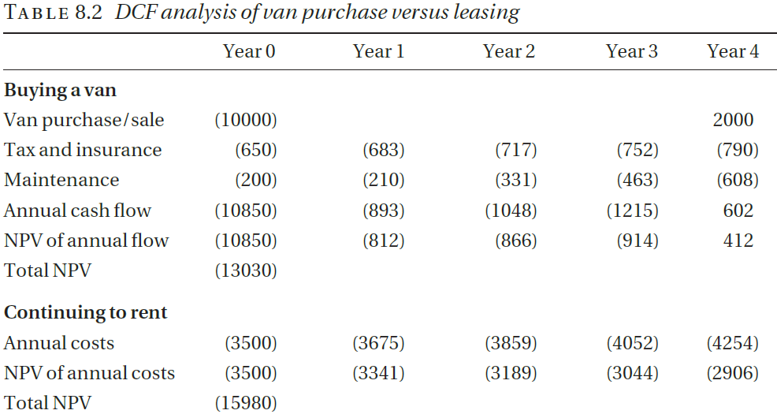
Notes:
A new van will cost £10,000. There will be annual costs of £500 for insurance
and £150 for road tax. The cost of maintenance is estimated to be £200
in each of the first two years, £300 in year 3, £400 in year 4 and £500 in year 5.
At the end of the fifth year, it is expected that the van will be sold for around
£2,000. The interest rate that the company pays on its borrowings is 10 percent.
Van hire costs £30 per day and it hires a van for about 100 days a year. All
the costs are subject to inflation, which is judged to be around 5 per cent over
the period, but the resale value of the van is the cash figure expected at the
time.
The NPV of the cost of continuing to rent is £15,980, while the NPV of the cost
of buying a van is £13,030. We conclude that the company will be better off by
buying a van. This conclusion depends, of course, on the validity of the
assumptions. The main uncertainty is in the number of days for which a van
would have to be rented. If the company’s business expands, so that it would
have to rent a van more often, the cost of the rental option would increase so
that buying would have more of an advantage. If, however, business declined
or the company were able to use the existing van more efficiently, the cost of
the rental option would decrease and the advantage of buying would be
reduced or even disappear.

Slide 14
Cost of capital
This means that even if the company can buy the van outright, it incurs an "opportunity cost" by not investing that cash elsewhere, where it could earn interest. In the discounted cash flow (DCF) analysis, this lost interest is effectively the cost of using cash to buy the van, so it’s used as the discount rate.
Suppose a company has £10,000 in cash and can either buy a new van with it or invest the money in a savings account that pays 5% annual interest. If the company buys the van, it loses out on the £500 it would have earned annually by investing the money. This lost potential earnings of £500 each year is the opportunity cost of using the cash to buy the van instead of investing it.

Slide 15
Handling inflation
What is inflation?
Inflation in a financial context means the fall in the value of money over time

Slide 16
Software company example
We consider a company that is assessing a proposal for the development of a software product. It is estimated that three people will be required for development in the first year and a further person and a half in the second year; suitable staff cost £35,000 per year, including the employer’s pension and national insurance costs. The product will be released in the second year. After the second year, maintenance is expected to require one person, full-time. Sales and marketing costs are estimated to be £10,000 in the first year, rising to £20,000 for each of the next four years.
The product itself is a fairly high-value but specialized product. It is expected that about 100 copies will be sold over this period, at around £5,000 a copy.

Slide 17
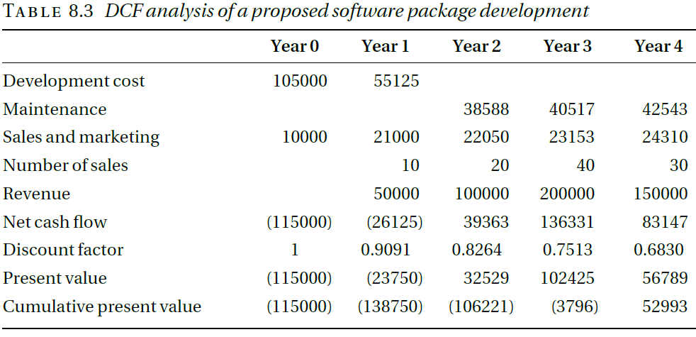

Slide 18
PITFALLS OF DCF
we must take into account that:
most software projects take more effort than expected;
most software doesn’t work very well when it’s first released;
we may not manage to sell as many copies as we expected;
there is a considerable risk that a competitor will launch a similar product before ours is ready.

